Slide 1

SECJ 2203 SOFTWARE ENGINEERING
SELF REFLECTION VIDEO: LEADERSHIP
Student Name : Koo Xuan
Matric No. : A23CS0300
Section : 01
Team ID & name: 08 (MINDWELL ORGANIZATION-SELF HELP SYSTEM)
Nurul Athirah Syafiqah binti Mohd Razali (A23CS0163)
Muhammad Hafiz Bin Mohd Shaharuddin (A23CS0130)
Phavanee Katriya Phon - Amnuaisuk (A23CS0170)

Slide 2

UNIVERSITI TEKNOLOGI MALAYSIA
Introduction
In this project, my role is a member who complete the task distributed together with my team members on time. Except from this, I’m also a moderator who monitor group progress to ensure the team stayed on track to achieve our goals.

Slide 3
UNIVERSITI TEKNOLOGI MALAYSIA
Project Overview
The project - MindWell Self-Help System, is a mobile-based mental health management platform designed to provide accessible, user-friendly tools for self-help and diagnosis. It integrates innovative features such as personalized toolkits, motivation and rewards, and mental health literacy resources to empower users to manage their mental health independently.

Slide 4
Background of the project
Objectives
Target Audience
Project Features
Key Stakeholders
Accessibility : Offer cost-effective, accessible mental health tools for individuals
Education : Enhance mental health literacy by providing educational resources (knowledge units) curated by professionals.
Engagement : Incorporate gamification features like points, badges, and avatars to motivate consistent user engagement.
Personalization : Allow users to customize their experience with a tailored toolbox of mental health techniques
End Users : Individuals seeking mental health support for self-diagnosis, progress tracking, and skill-building.
Mental Health Professionals : Psychologists and consultants providing expertise and ensuring content accuracy and cultural relevance.
Stakeholders : Developers, designers, and organizations involved in developing or funding mental health solutions.
User Management : User registration, login, profile customization, and password recovery.
Mental Health Literacy : Access to knowledge units, bookmarking, and rating of educational resources.
Skill-Building Toolbox : Tools that users can add, evolve, or remove based on their preferences.
Motivation and Rewards : Points, badges, and customizable avatars to engage users and encourage participation.
Admin Management : Content management by administrators, including resolving flagged issues and monitoring diagnostic trends.
Content Creation : Tools for professionals to create new knowledge units tailored to user needs.
Psychologists and Mental Health Advocates : To ensure the system meets industry standards and user needs.
Developers and Designers : Responsible for building a scalable and secure system.
End Users : Provide feedback to improve the platform and its usability.

Slide 5
Sprints
01
User Management Module
Basic user management, including registration, login, and profile management.
02
Mental Health Literacy Module
Development Process
Introduction of knowledge units for browsing, bookmarking, and rating.
03
Skill-Building Toolbox Module
Development of the toolbox module for personalized self-help tools.
04
Motivation and Rewards Module
Gamification features to boost engagement with points, badges, and avatars.
The project followed an Agile development methodology, organized into six sprints
05
Admin Management Module
Admin functionalities like managing content and monitoring diagnostic trends.
06
Content Creation Module
Empowering mental health professionals to create and share valuable content.

Slide 6
UNIVERSITI TEKNOLOGI MALAYSIA
Self-Reflection
In this project, I had the opportunity to develop and apply key leadership skills and qualities that were instrumental in guiding our team toward success. Through the course of Assignments 1 to 4, I gained insights into effective team management, collaboration, and problem-solving in a dynamic, real-world project setting.

Slide 7
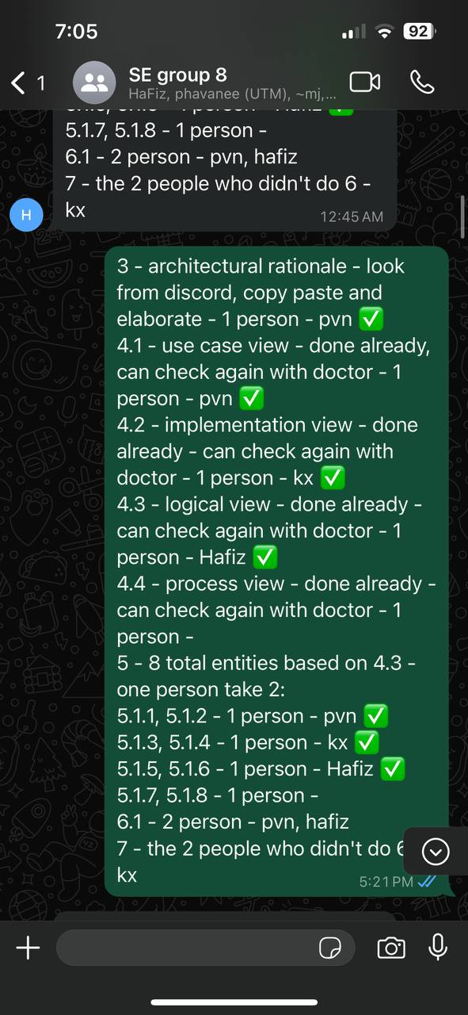
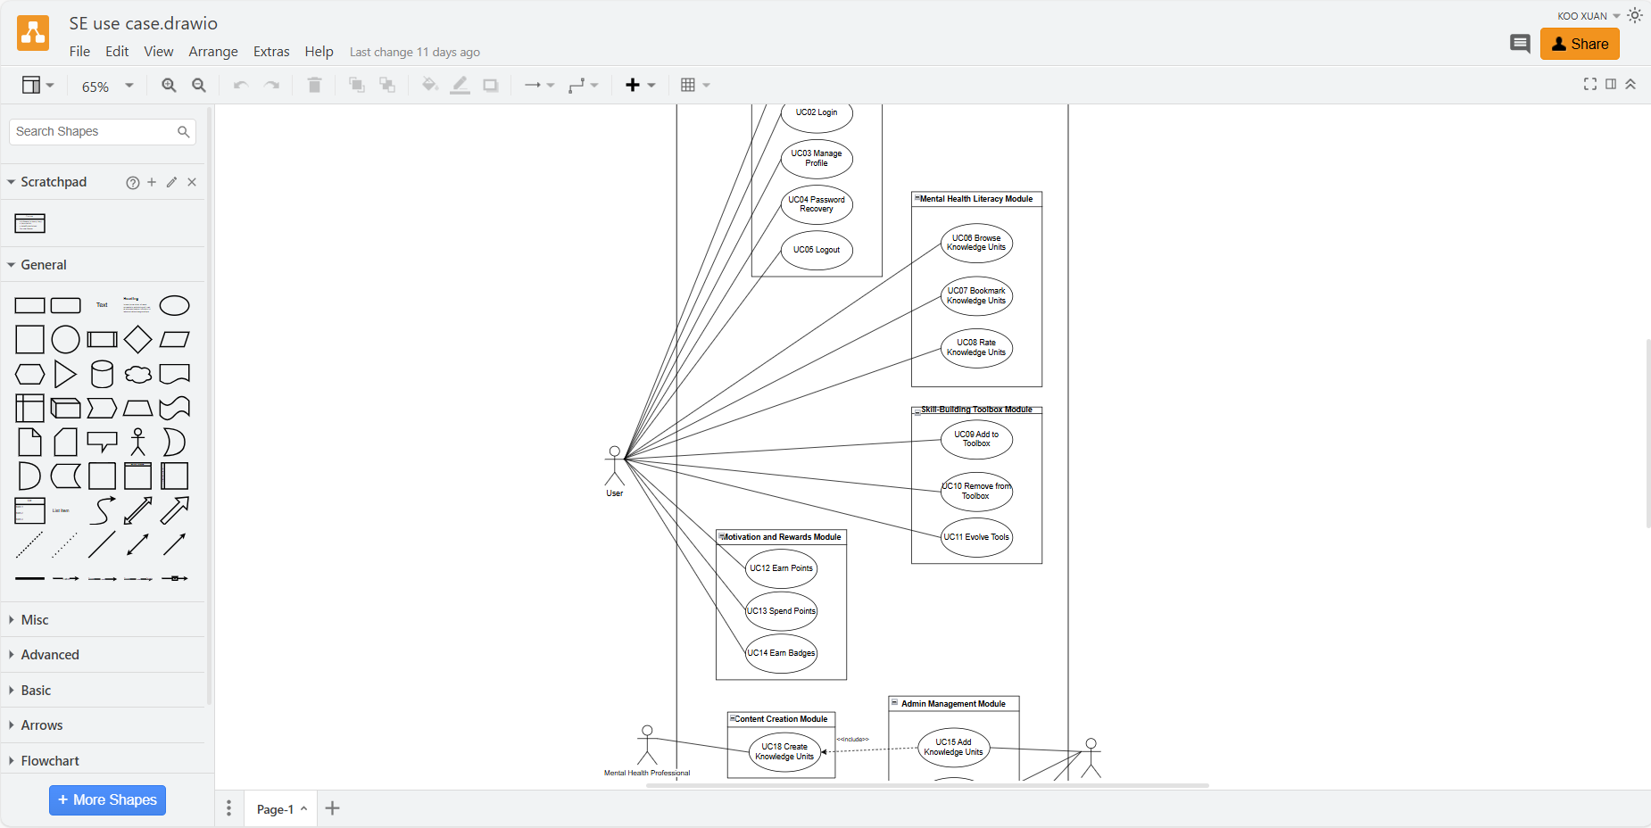
Knowledge and Skills
01
02
03
Project Planning and Management
Technical Expertise
Communication and Collaboration
We used Agile principles to structure our project into manageable sprints, enabling us to achieve steady progress.
Developed sprint backlogs to track task allocation and completion.
Familiarity with tools like draw.io for designing use case diagrams and sequence diagrams allowed me to contribute to system design discussions.
Facilitated team meetings to ensure clear communication of objectives and deadlines.
Encouraged knowledge sharing among team members to enhance productivity and learning.
Picture 2 : discuss and distribute task in group through whatsapp
04
Problem-Solving
Addressed bottlenecks promptly by re-allocating resources or adjusting timelines where necessary.
Helped the team resolve technical challenges during sprint execution by fostering collaborative discussions.
Picture 1 : using draw.io to complete our task

Slide 8
Vision and Goal Setting
Ensured the team stayed aligned with the project's vision of creating an accessible mental health platform.
Set clear and achievable goals for each sprint, motivating the team to deliver quality work consistently.
Adaptability
Maintained flexibility in response to unexpected challenges, such as task delays or technical hurdles, while keeping the project on track.
Leadership Qualities
Empathy and Support
Actively listened to team members' concerns and provided support when needed.
Created a positive environment that encouraged open feedback and creative problem-solving.
Accountability and Responsibility
Took ownership of monitoring group progress and ensuring deadlines were met without compromising quality.
Regularly updated the team on progress, fostering transparency and trust.
Decision-Making
Made informed decisions during critical moments, such as prioritizing tasks or resolving conflicting opinions within the team.

Slide 9
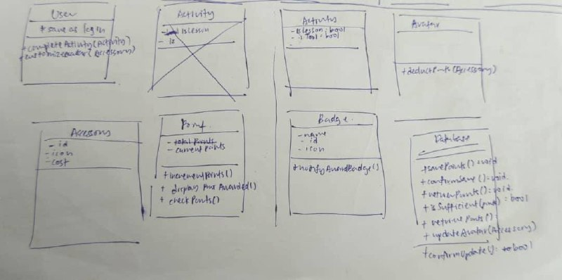
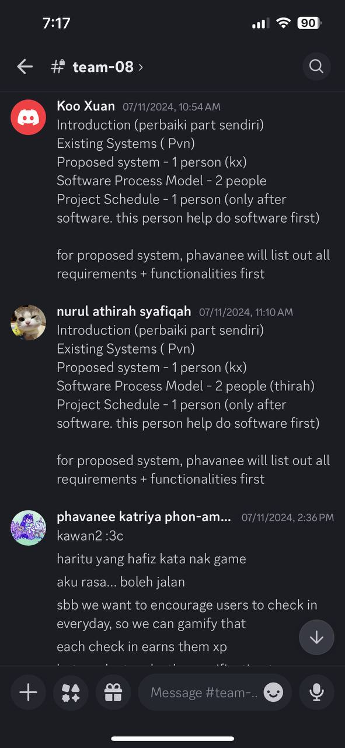
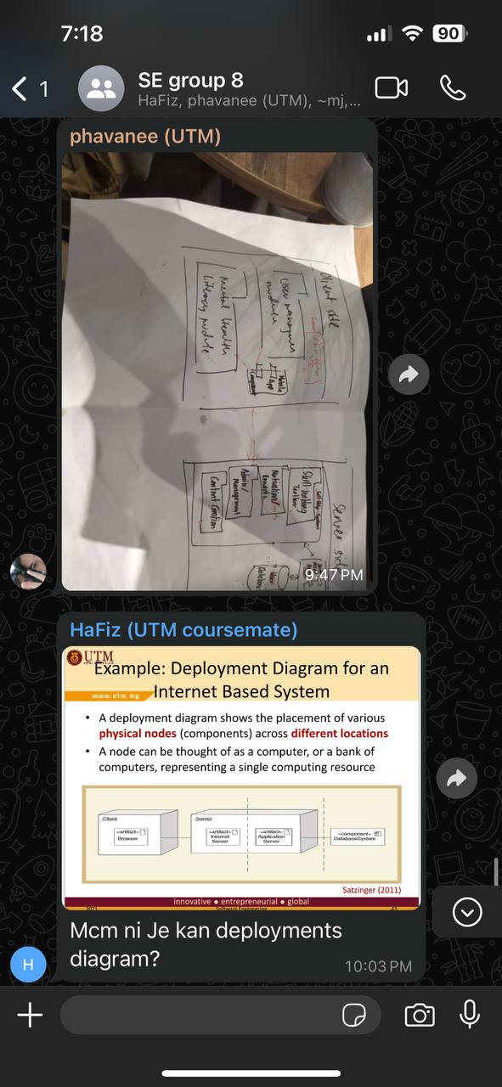
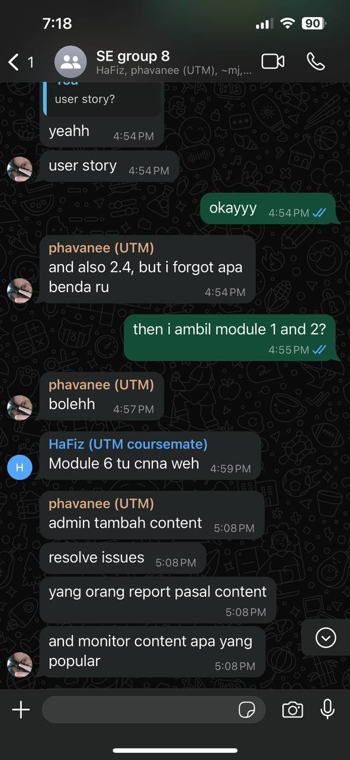
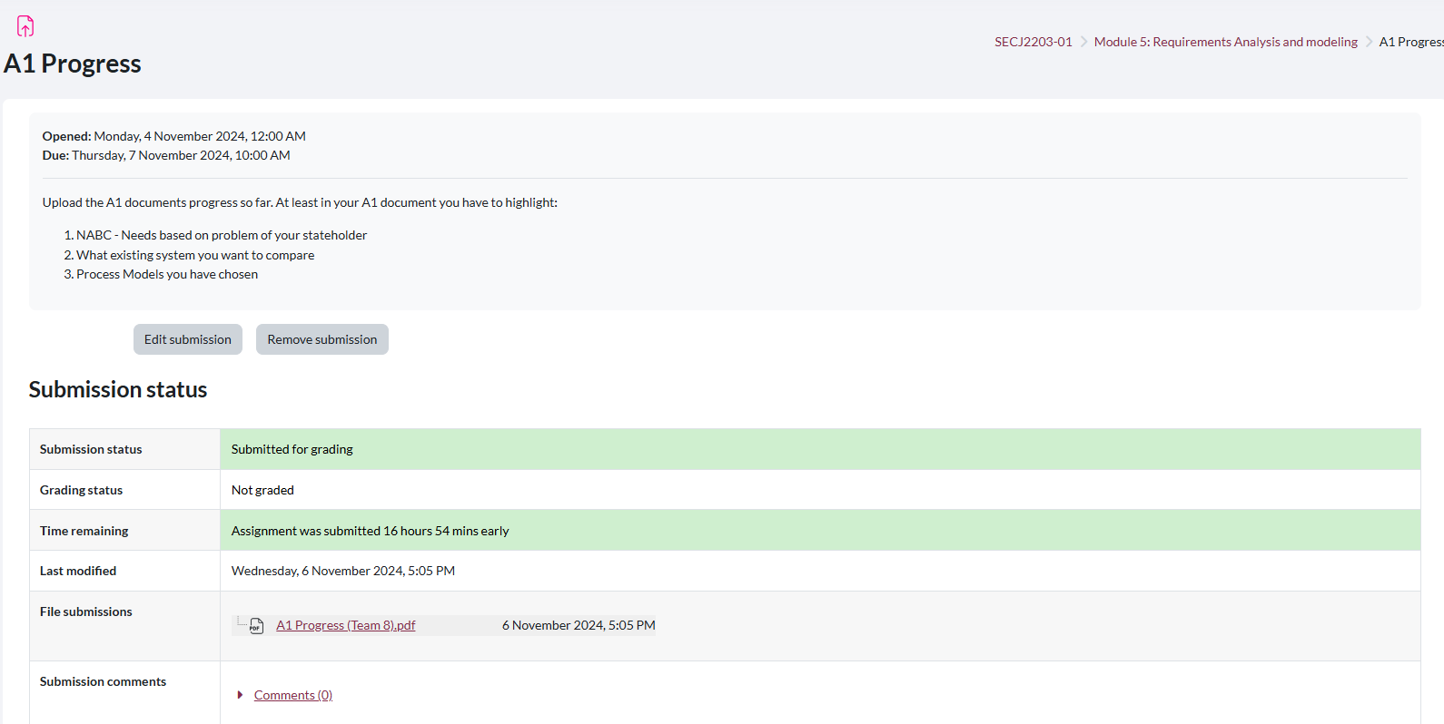
Evidences
Picture 6 & 7 : discuss using whatsapp
Picture 3 : discuss for draft of class diagram for the system
Picture 5 : discuss using discord
Picture 4 : e-learning submit work on time

Slide 10
Conclusion
“
This project has been a fantastic learning journey for me, not just in terms of leadership but also in understanding the practical aspects of software engineering. I developed skills in communication, problem-solving, and team coordination, which were crucial to keeping everything on track. The Software Engineering course introduced me to Agile methodologies, like sprint planning and iterative development, which made managing the project more organized and flexible. I also learned how important it is to focus on user needs and work collaboratively with a team. This experience has shown me how rewarding it is to see a project come to life and has prepared me to take on future challenges with confidence and adaptability.
“

Slide 11


THANK YOU
utmofficial
univteknologimalaysia
utm.my
Video link : https://youtu.be/OewG4Q3L9wg

